Slide 1
EcoSLIM
Princeton GPU Hackathon
Members
Jun Zhang, The University of Arizona
Hoang Tran, Princeton University
Chen Yang, Princeton University
Mentors
Troy Comi, Princeton University
Carl Ponder, NVIDIA

Slide 2
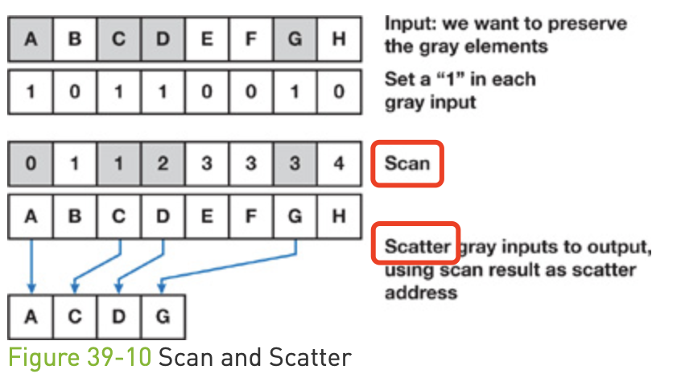
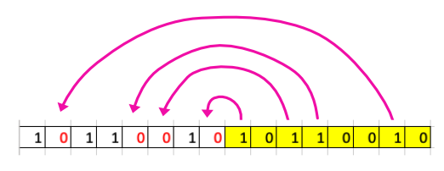
Progress and Goals
What have you accomplished since June 2?
Scan part was finished by writing a wrapper calling
inclusive_scan in Thrust.
Carl figured out an in-place compaction/scatter to
deal with the huge number of particles on GPU
which is memory limited. (100-million*20 double precision)
We wrote the kernel and preliminarily tested it.
What are your goals for the day?
To fix the race condition issue and update test.
Working with Troy for long-term maintenance
of the code by using cmake.
In-place compaction

Slide 3
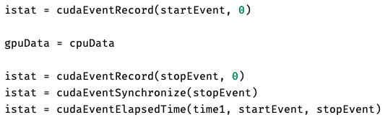
Profiler Output
1s*8760*40/3600/24=4days saved
The test results using an array of size 80,000,000*10 for serial and parallel codes:
Environment (Della-GPU cluster): AMD EPYC 7H12 64-Core Processor, NVIDIA A100 GPU, nvhpc/21.1, cudatoolkit/11.1
a. the parallel code used 10.685 ms, the serial code used 1445.623 ms, so the speedup is 135-fold(1445.623/10.685)
b. considering that it is not necessary to transfer data if using parallel code on GPU, it is 190-fold((1445.623+344.304+244.287)/10.685)
Currently, just timing; Try to use profilers such as Nsight in the following days.

Slide 4
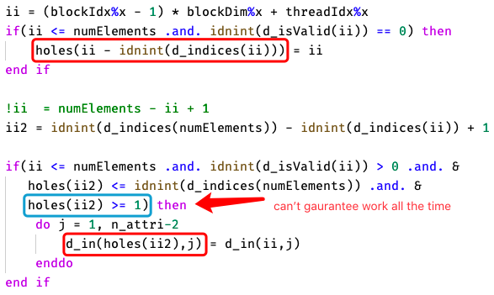
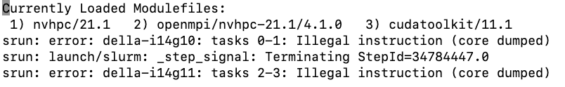
Problems and Solutions
What problems are you currently facing?
Race condition
separate it to two kernels
Have you resolved any problems (or found bugs) that others might find useful?
Multi-GPU with MPI code can run on Della-GPU with help of Jon, Gabe, and Troy.

